Slide 1
Paper Presentation
Paper Title : A Technical Question Answering System with Transfer Learning
Authors : Wenhao Yu, Lingfei Wu, Yu Deng, Ruchi Mahindru ,Qingkai Zeng, Sinem Guven,
Meng Jiang
Reference : Proceedings of the 2020 EMNLP (Systems Demonstrations), pages 92–99,
November 16-20, 2020. Association for Computational Linguistics.
Submitted By:
Saif Shahnewaz Saad - 16101181
A. A. Noman Ansary - 18301147 Adib Muhammad Amit - 19101657
Amit Dutta - 21166028
Submitted to:
Annajiat Alim Rasel
Senior Lecturer,
Department of Computer Science and Engineering,
Brac University.

Slide 2
Abstract & Introduction
Motivation behind Automated Question Answering :
Tech Question-Answering sites are increasing day by day (technical QA especially).
It is expensive to allocate Human resources.
Automated QA will result in faster query responses.
Limited domain-specific knowledge to describe issues or to address one.
Forum answers may contain additional/irrelevant information.
Forum discussions may lead to off-topic discussion among the participants.

Slide 3
Proposal of the Paper
To use Transfer Learning based approach to handle automation for tech related QA as a demonstration in their own project called “TransTQA”.
Features/Implementation :
Siamese ALBERT (A Light BERT) has been used for question and answer embedding
Leverages accepted questions and answers tagged by human users.
Used 4 types of Transfer Learning strategies.
Returns 3 best ranking answers from sources (askubuntu/stackoverflow etc. in their implementation) but cross checks documentation

Slide 4
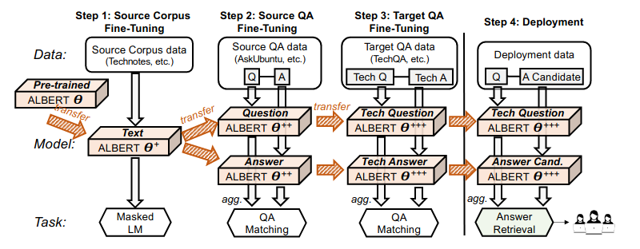
Workflow
The workflow in a glance :

Slide 5
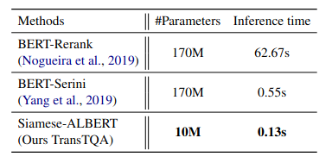
Related Works and Relative Evaluation
Related methodologies/architecture for the same issue addressing include: 1. BERT-Rerank 2. BERT-Serini (anserini and BERT hybrid)
Comparison :

Slide 6
Conclusion
It can help the tech enthusiasts on a large scale
MRR (Mean Reciprocal Rank) is good
Finding the highest pair of similarity has been optimised in contrast to traditional and widely used BERT models
Transfer learning implemented in the proposal gives the best of both experts’ opinion along with the official documentation
Thank You!

